Slide 1





PROJECT ON
WEB SCRAPPING AND EXPLORATORY DATA ANALYSIS ON
SHIKSHA EDUCATIONAL WEBSITE

Slide 2

AGENDA
Introduction
Problem Statement
Objective
Web Scrapping
Dataset Overview
Data Preprocessing and Cleaning
Data Visualization
Technologies Used
Conclusion
Experiences & Challenges

Slide 3
INTRODUCTION
This project focuses on web scraping and exploratory data analysis (EDA) of education-related data from the Shiksha educational website. The objective is to collect structured information such as college names, college types, courses offered, fees, ratings, and locations and analyse this data to identify meaningful patterns and trends.
Using Tools and techniques like Requests, Beautiful soup and Regular expressions the project demonstrates an end-to-end data analytics workflow — from raw web data to actionable insights.

Slide 4
PROBLEM STATEMENT
Students and parents often rely on online education platforms to compare colleges and courses. However, the information is typically spread across multiple web pages and presented in an unstructured format, making comparisons time-consuming and insufficient. Without a structured, data-driven analysis, it becomes difficult to understand trends related to fees, course popularity, college ratings, and geographic distribution. This project addresses the need to transform scattered web data into organized insights that support better educational decision-making.

Slide 5
OBJECTIVE
To extract education data from the Shiksha platform using web scraping techniques.
To structure and clean raw web data for accurate analysis.
To analyze colleges based on type, courses, fees, ratings, and location
To identify trends and patterns through exploratory data analysis.
To visualize insights that enable easy comparison between colleges.
To showcase practical skills in Python, web scraping, and data analytics.

Slide 6









TECHNOLOGIES USED

Slide 7
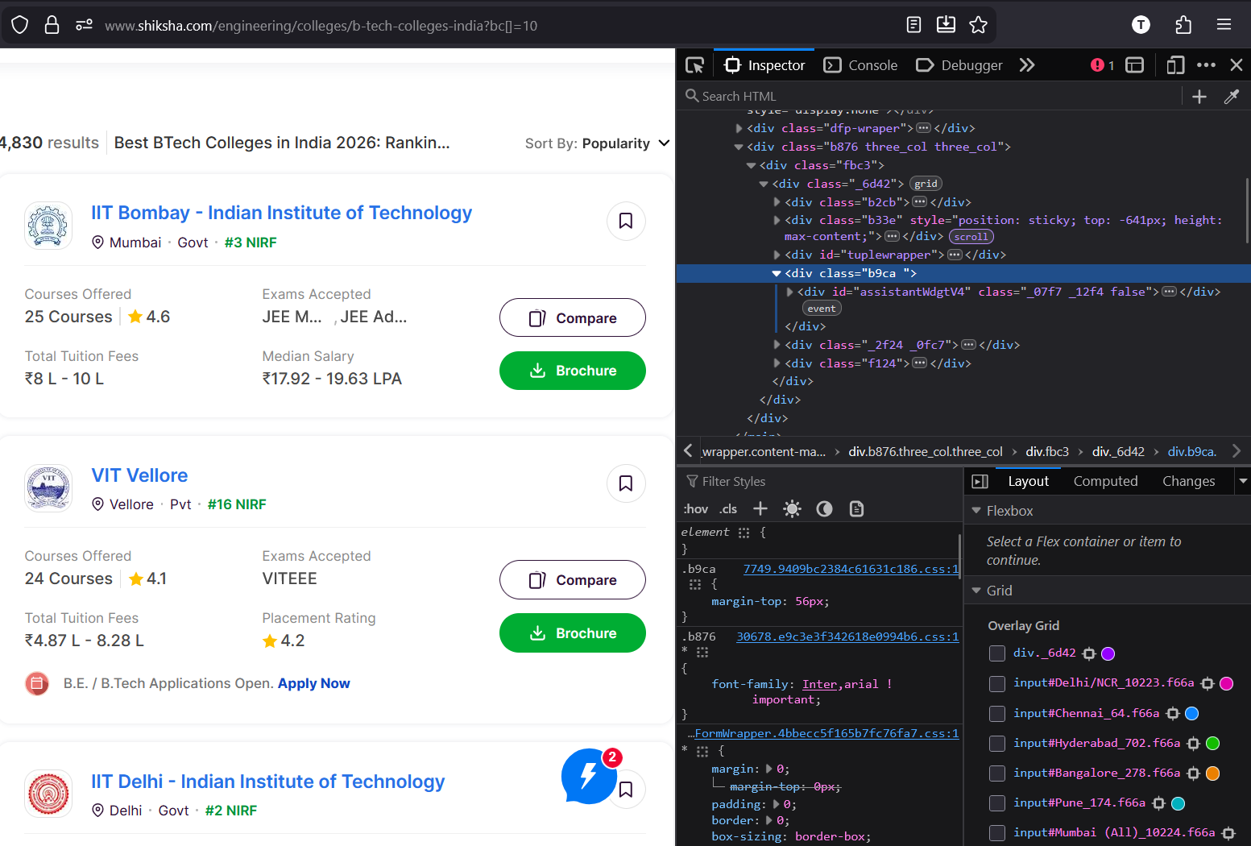

WEB SCRAPPING
Web scraping is the automated extraction of data from websites.
In this project, BTech college data is collected from the Shiksha website using Python libraries like Requests and Beautiful Soup and structured for further analysis and visualization.
Extracted details like college name, ranking, fees, and courses.

Slide 8
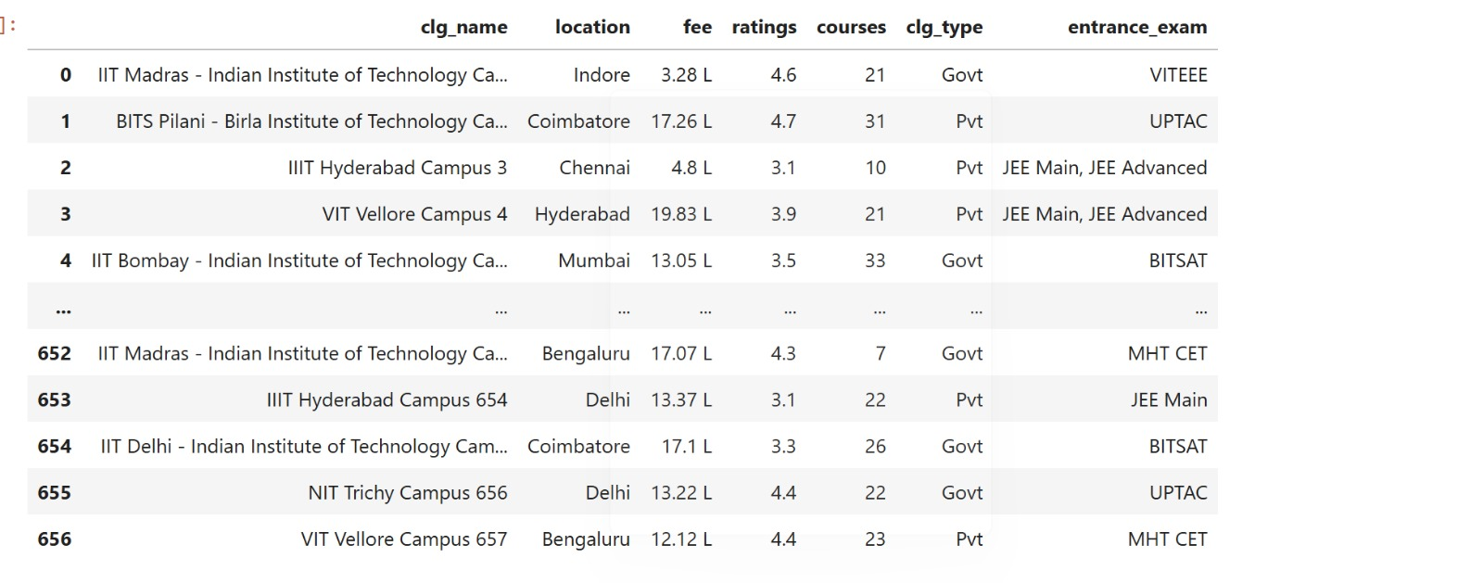

RAW DATASET OVERVIEW

Slide 9
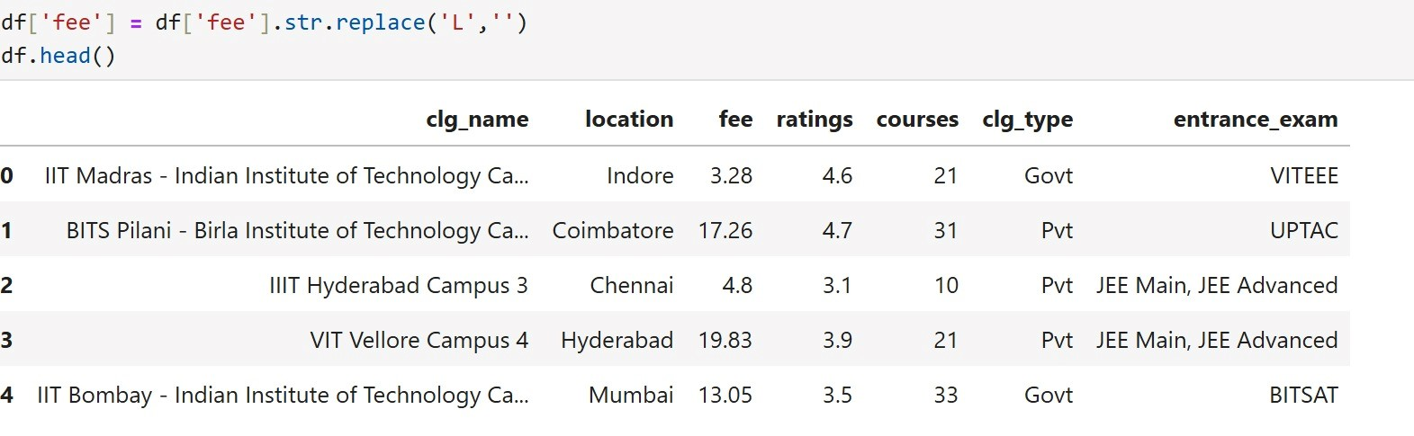
DATA CLEANING
The fee column was cleaned by removing unit notation (‘L’) to convert values into a consistent numeric format for further analysis.

Slide 10
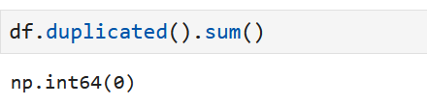
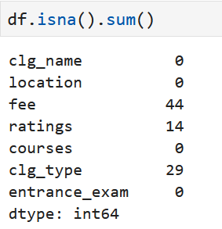
Shows how many duplicate rows exist in the dataset and helps avoid repeated information.
There are 0 duplicates, so no cleaning needed here.
Displays how many values are missing in each column so we can decide how to clean or fill them.

Slide 11
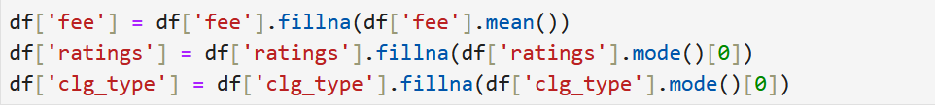
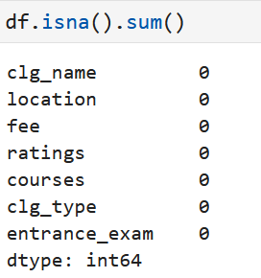
HANDLING MISSING VALUES
Missing values were handled by replacing numerical data with mean and categorical data with mode to maintain data consistency.
After preprocessing, all missing values were validated and confirmed as zero across the dataset.

Slide 12
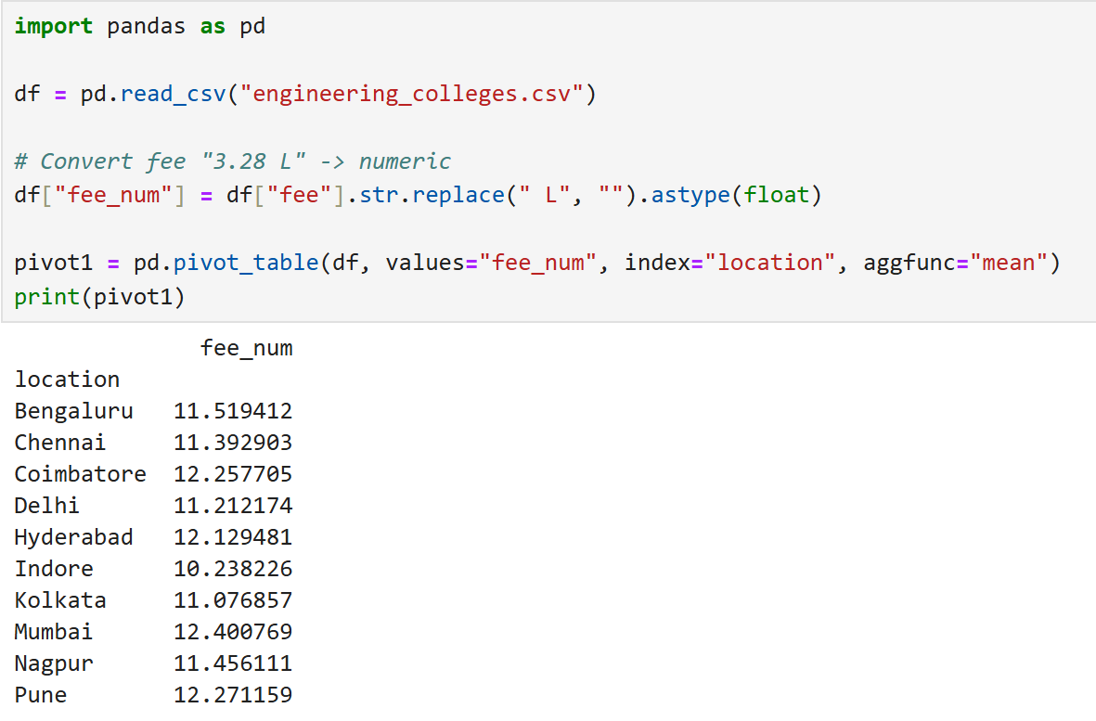
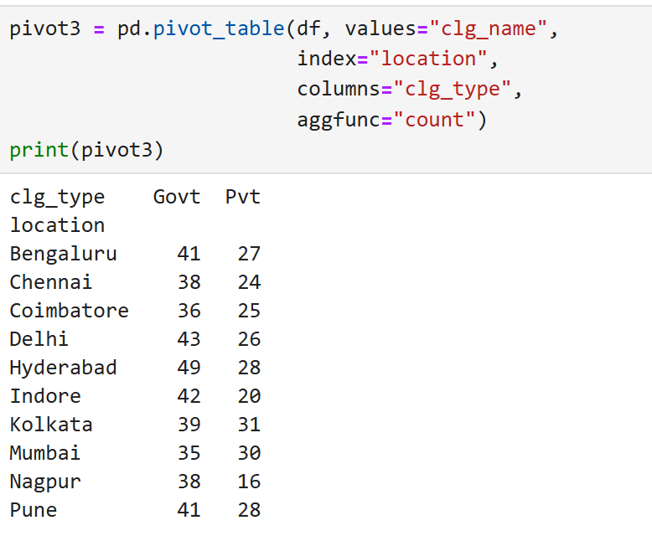
PIVOT TABLE:
Some locations have higher average fees, meaning colleges there are more expensive.
Most locations contain more private colleges than government colleges.

Slide 13

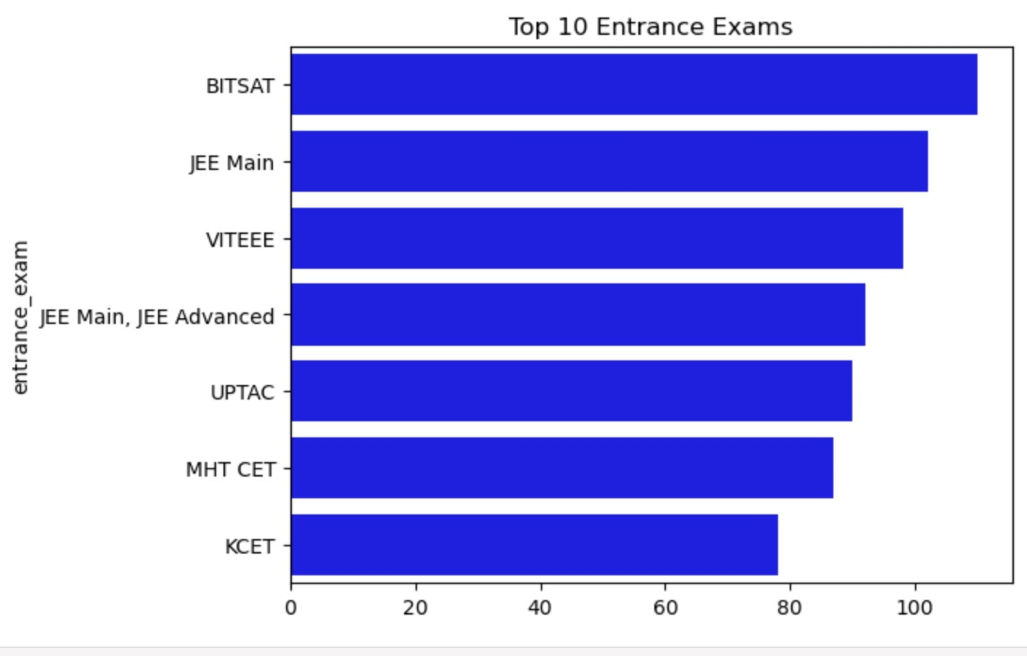
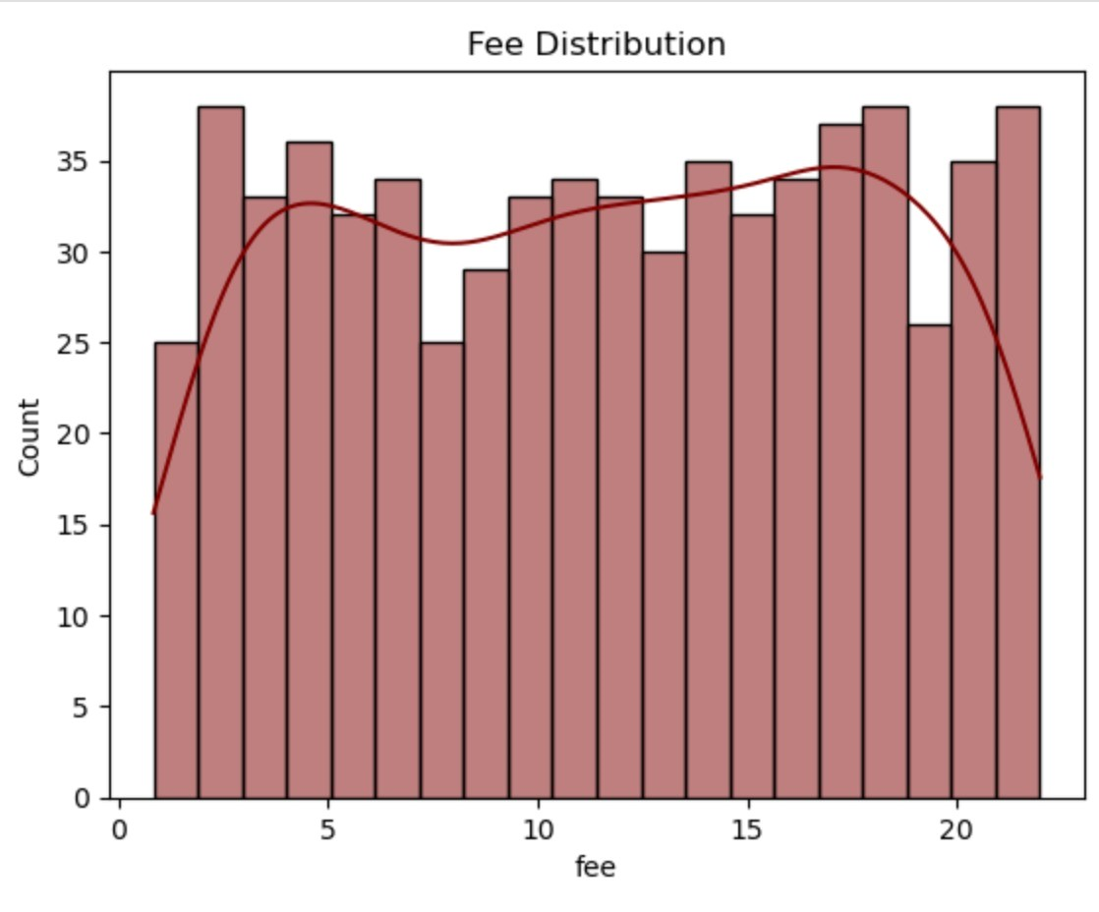


DATA VISUALIZATION
UNIVARITE ANALYSIS:
The fee distribution is right-skewed, with most institutions charging lower fees and a few having significantly higher fees as outliers.
The chart shows that JEE Main and MHT-CET–related exams are the most dominant entrance pathways, followed by board-linked exams like CBSE/Tamil Nadu, while other exams appear less frequently, indicating more specialized or region-specific admissions.

Slide 14

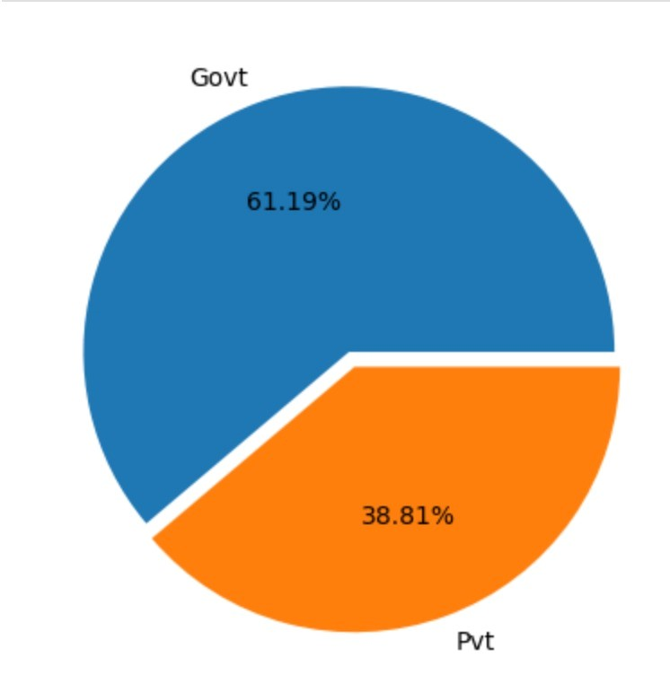
The chart shows that private colleges dominate the dataset, making up nearly four-fifths of institutions, while government colleges form a much smaller share.
COLLEGE TYPES:

Slide 15

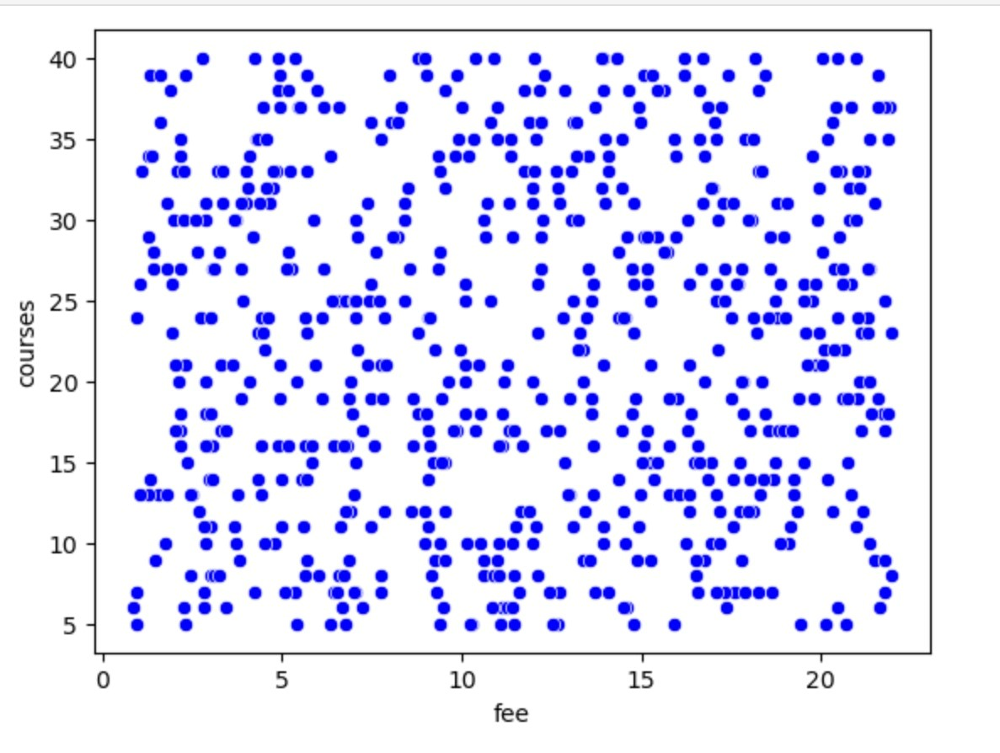
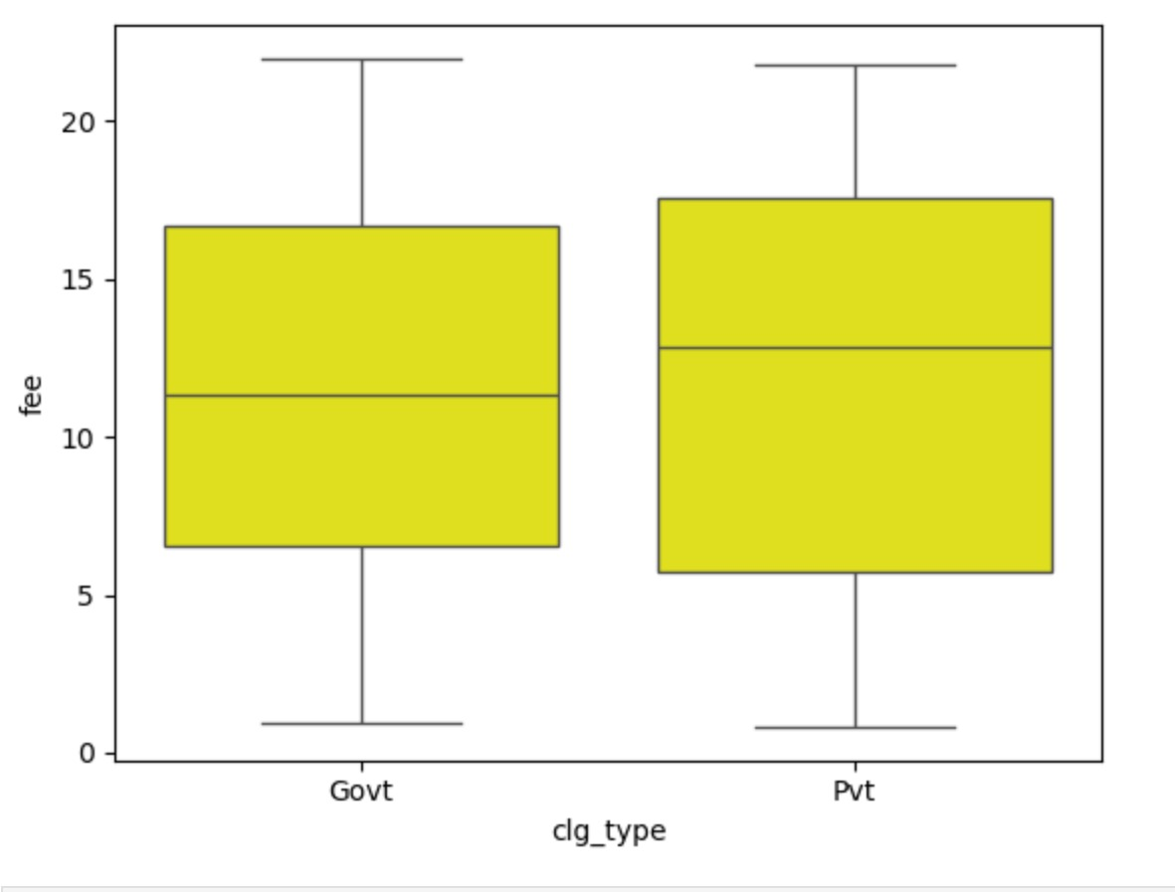


BIVARIATE ANALYSIS:
College types and their fees:
Fees and courses:
Government and Private colleges have similar median fees, but Private colleges show greater variability with more high-fee outliers.
There is a weak negative relationship between fees and number of courses, with most colleges offering fewer courses at lower fee ranges.

Slide 16
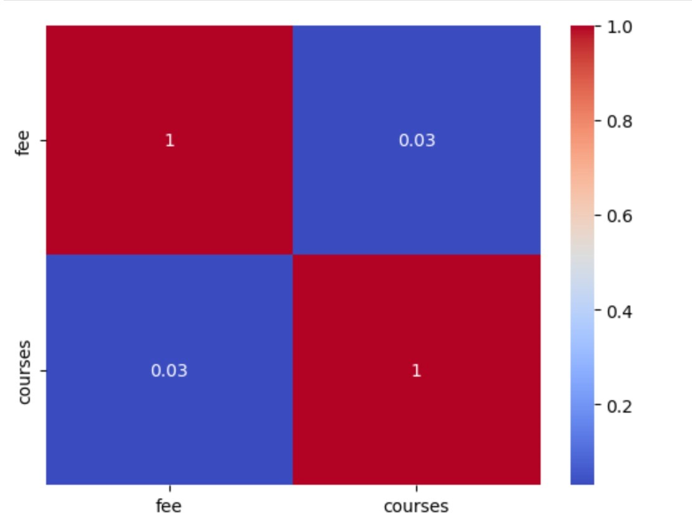
Correlation between course and fee:
The heatmap shows a near-zero correlation (0.03) between fees and number of courses, indicating almost no linear relationship.

Slide 17
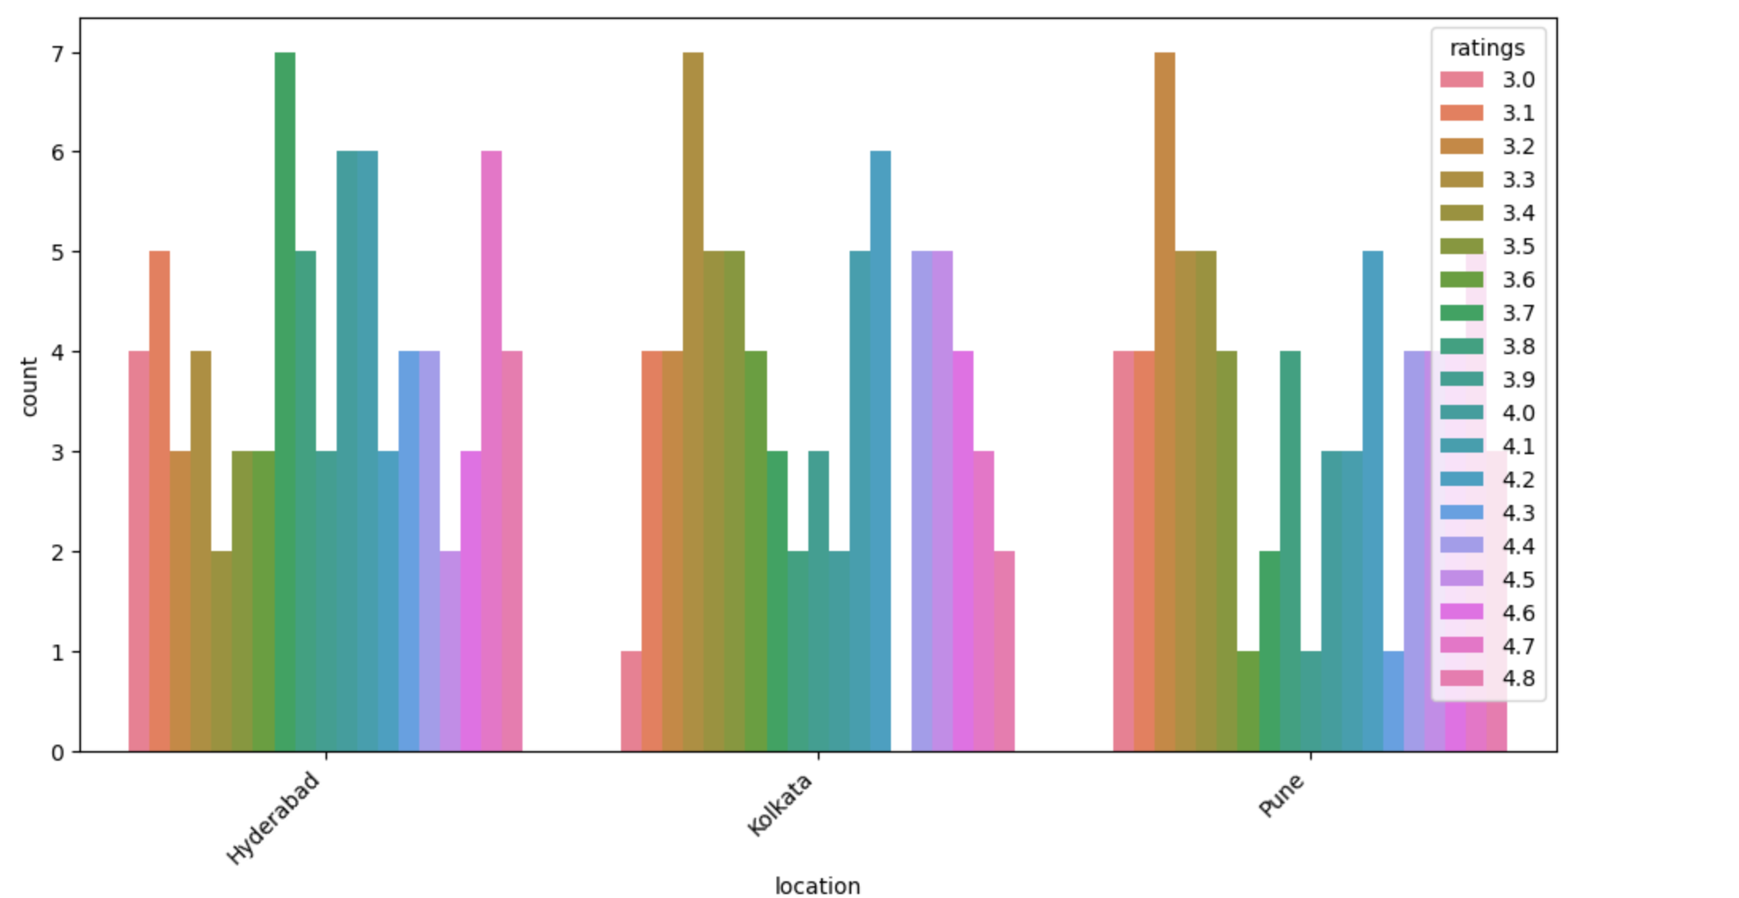

MULTIVARIATE ANALYSIS:
“Among the top locations, Kolkata and Hyderabad have more higher - rated colleges, while Pune shows relatively moderate rating distribution.”

Slide 18

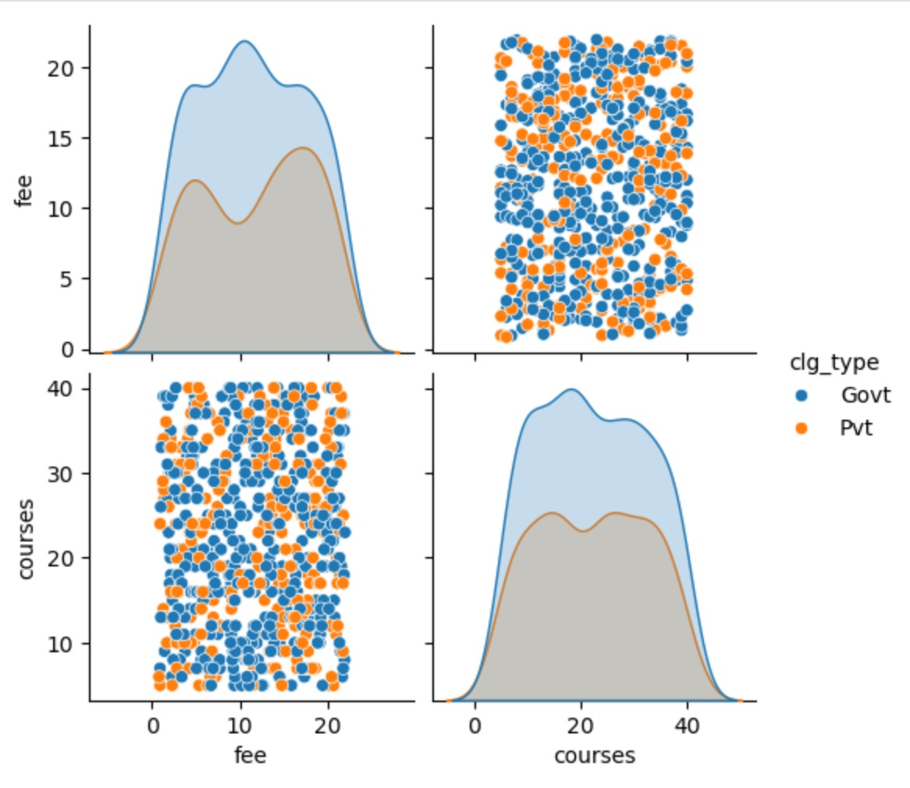
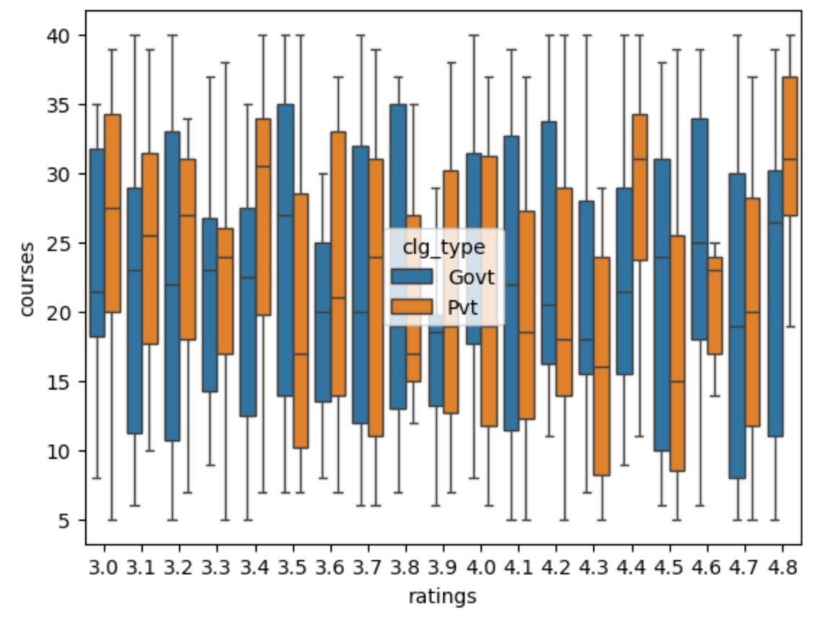


College types, their fees and courses offered:
College types, their courses and ratings:
Private colleges show higher fees and wider course offerings, while Government colleges cluster at lower fees with fewer courses.
Across ratings, Private colleges generally offer a wider range and higher number of courses compared to Government colleges.

Slide 19
CONCLUSION
This project successfully demonstrated the use of web scraping techniques to collect data efficiently from online sources. It provided practical experience in handling real-world, unstructured data and converting it into a usable format for analysis. Overall, the project enhanced technical skills, problem-solving ability, and understanding of ethical data collection practices.

Slide 20
EXPERIENCE & CONCLUSION
Gained hands-on experience with web scraping tools and understanding website HTML structure.
Learned to extract, clean, and organize unstructured web data.
Understood how real-world data is often unstructured and inconsistent.
Faced challenges like missing or inconsistent data, and website restrictions.
Ensuring data accuracy and ethical usage.

Slide 21
THANK YOU

